Slide 1


JavaScript Basics
Functions
DOM API

Slide 2
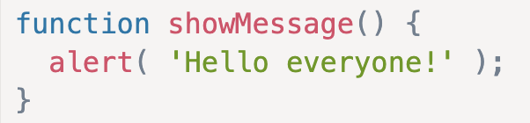
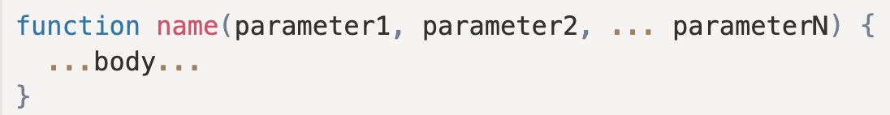
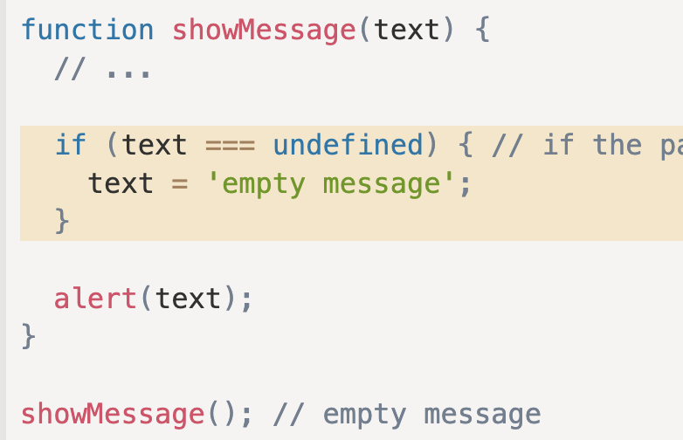
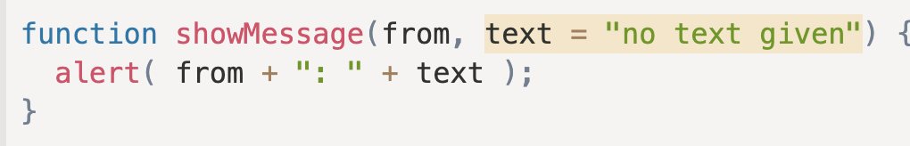
Functions
A JavaScript function is a block of code designed to perform a particular task.
Functions are the main “building blocks” of the program. They allow the code to be called many times without repetition.
Function Declaration
Default values

Slide 3
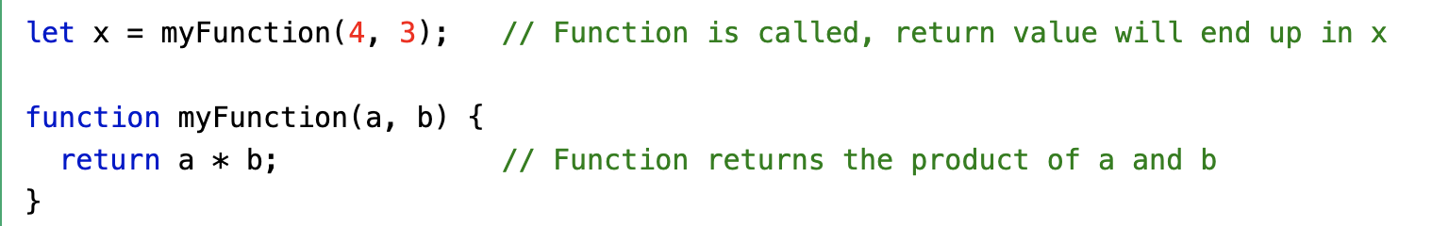
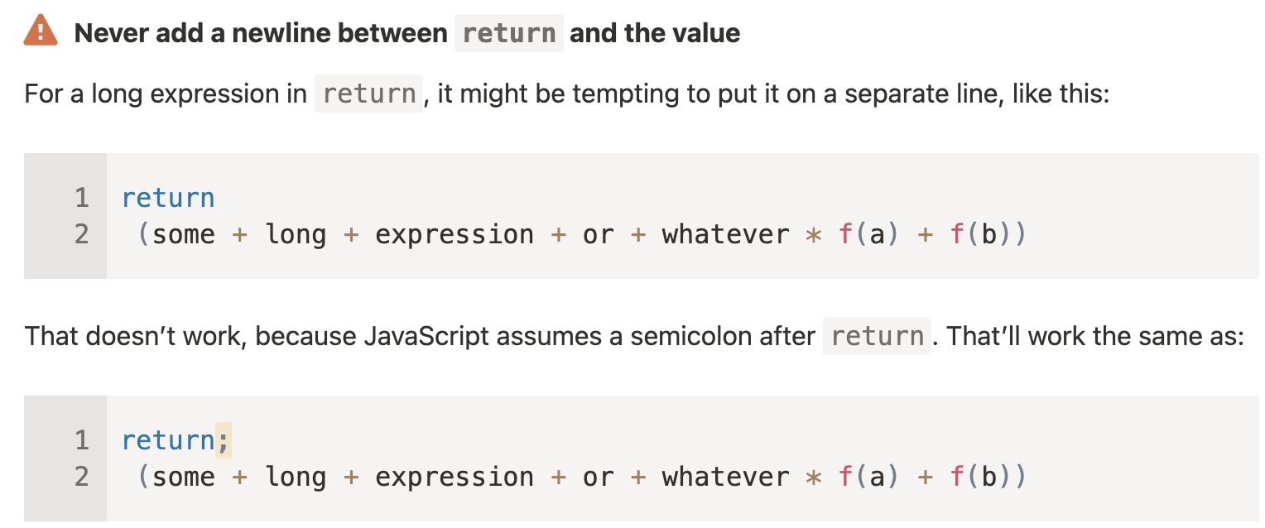
Function Return

Slide 4
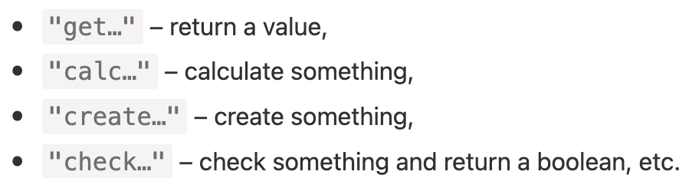
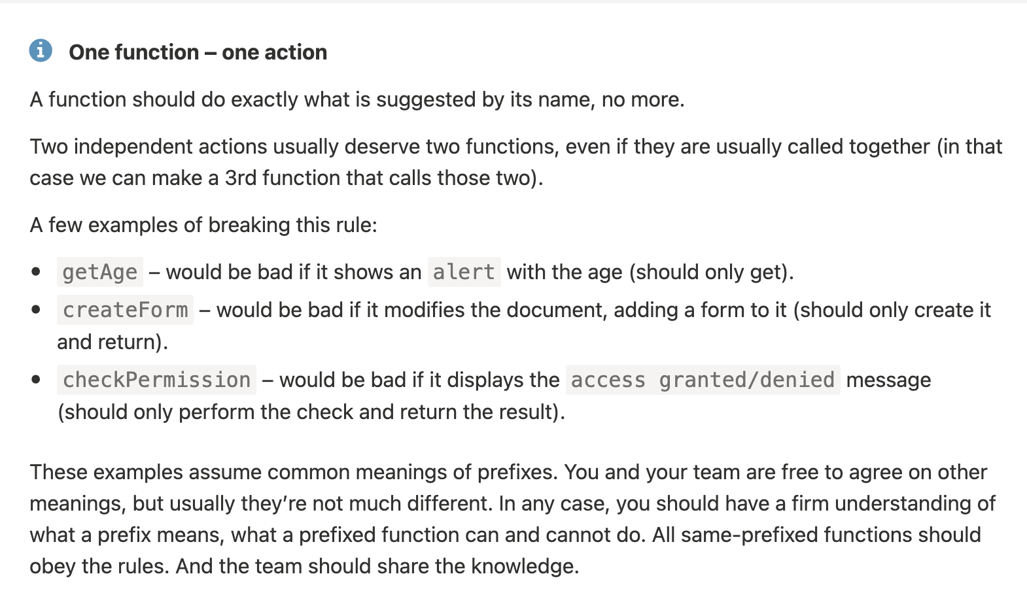
Function naming

Slide 5
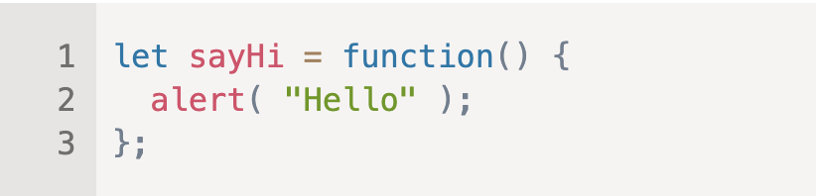

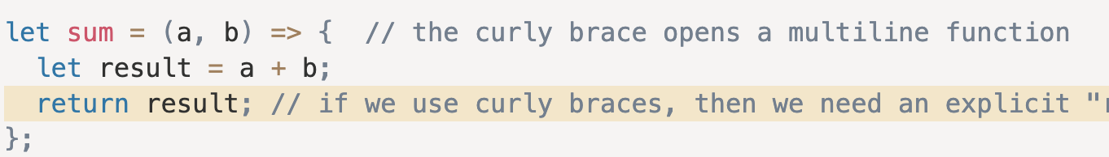
Function Expressions
Arrow functions
Callback functions
Any function that is passed as an argument to another function so that it can be executed in that other function is called as a callback function.

Slide 6
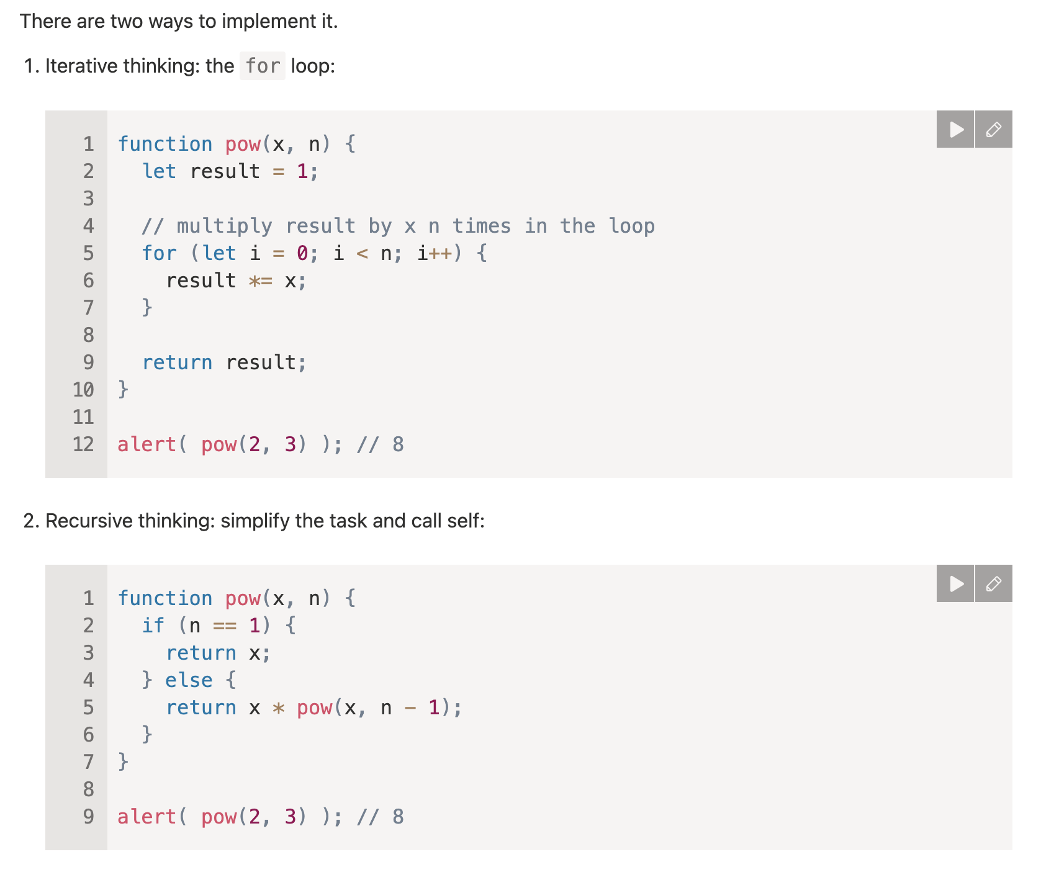
Recursion
When a function solves a task, in the process it can call many other functions. A partial case of this is when a function calls itself. That’s called recursion.

Slide 7
Tasks
Create a function which calculate sum of 2 arguments and return it
Create a function which finds minimum value of 2 arguments and return it.
Create function which receive number and check if that number is prime or not.
Write a function which receive number and if number is bigger than 10 calls (cb1) and (cb2) otherwise
Create a functions which receive a number(string length) as argument and generates random string which received length. (Use Math.random)

Slide 8
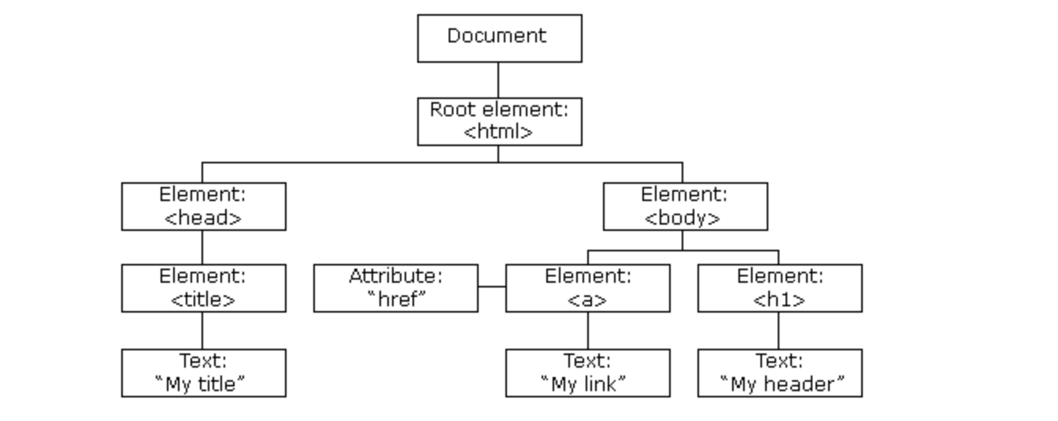
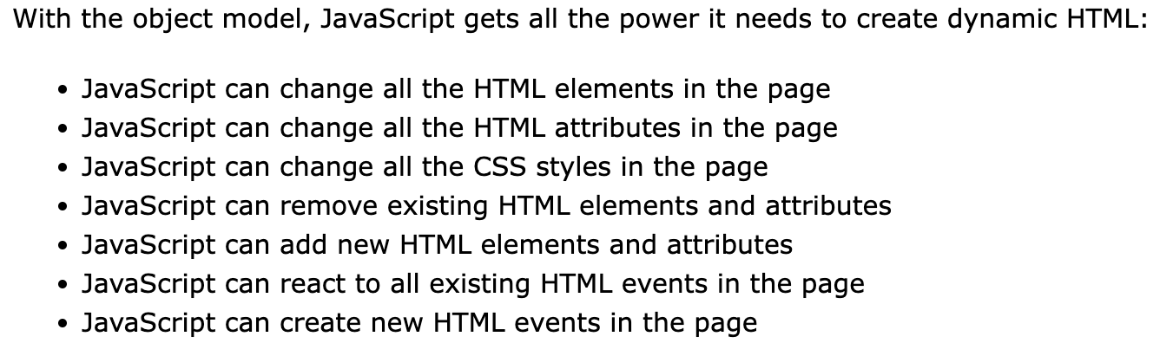
JavaScript HTML DOM

Slide 9
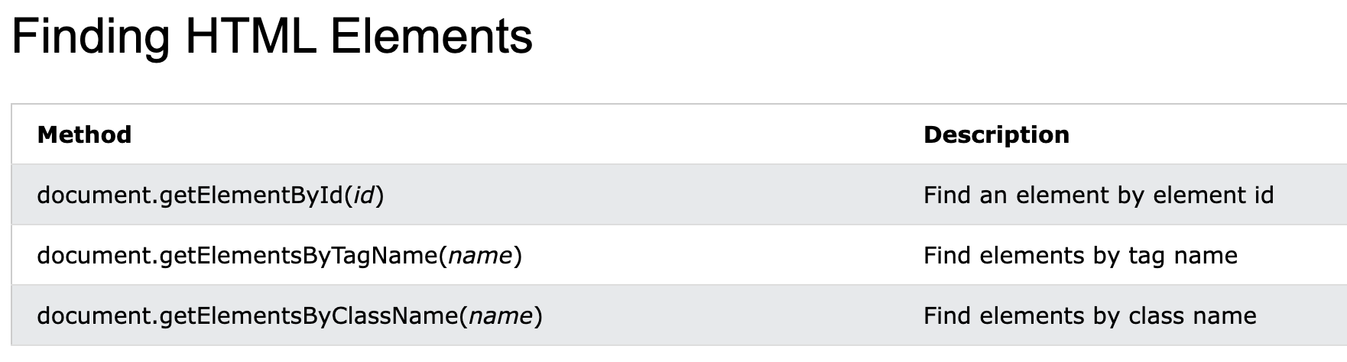
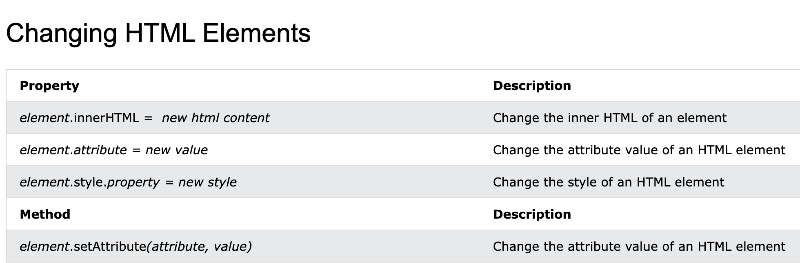

Slide 10
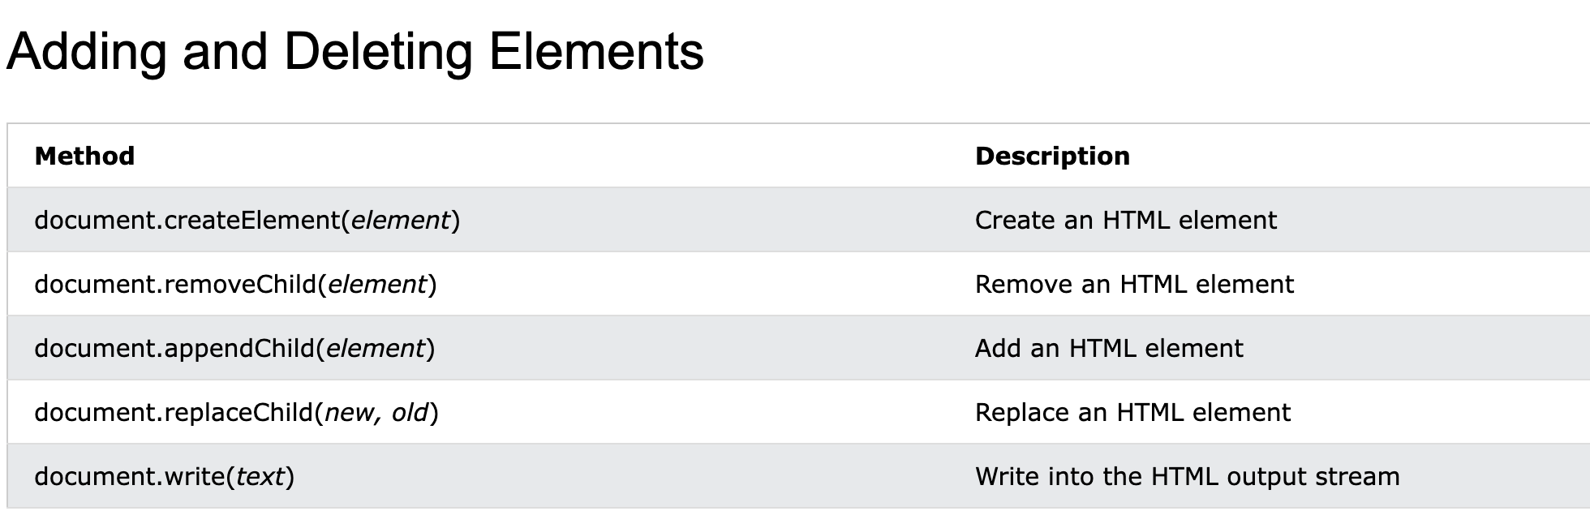
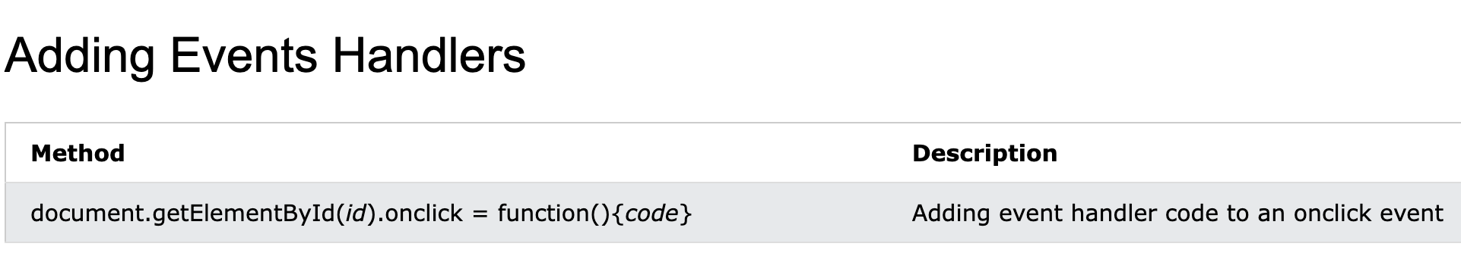

Slide 11
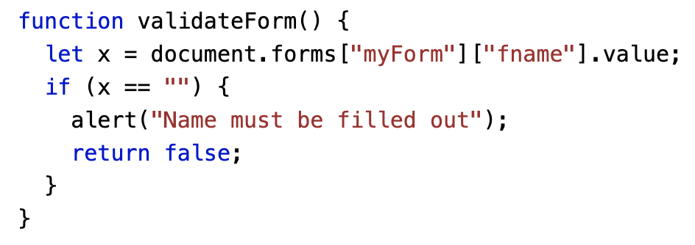
Form Validating

Slide 12
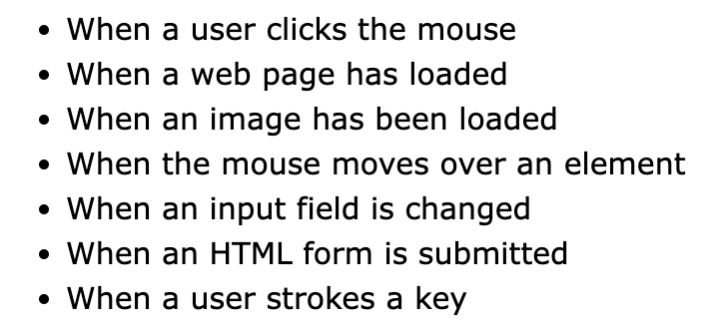
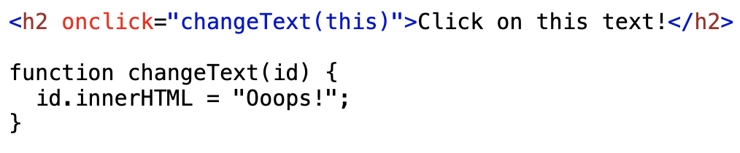
DOM Events

Slide 13
DOM Events list

Slide 14
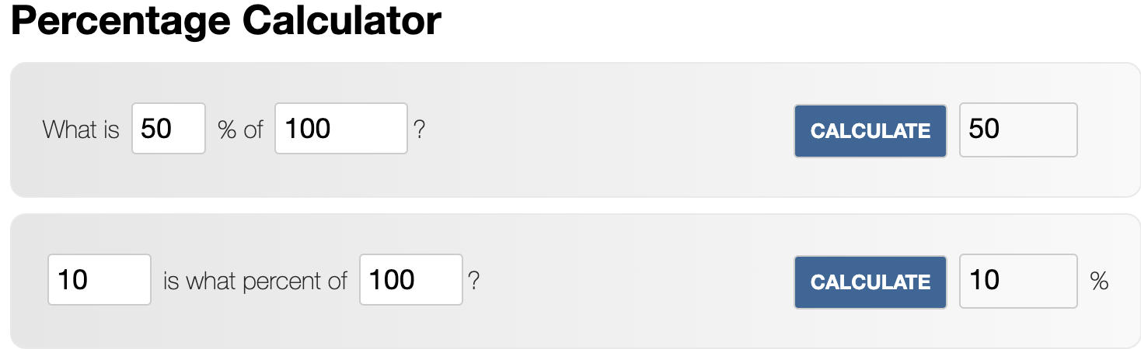
Tasks
Create a form and validate inputs on submit
Implement Percentage Calculator

